Slide 1
A PATHWAY TO A SUSTAINABLE AGRICULTURE. CASE STUDY OF ENTRE RÍOS, ARGENTINA. O. Valentinuz*, M. Siede, C. Seiler, O. Caviglia, I. Truffer, C. Main, W. Mancuso, R. Brassesco
INTRODUCTION
STUDY CASE
RESULTS
CONCLUSIONS
*valentinuz.oscar@inta.gob.ar

Slide 2
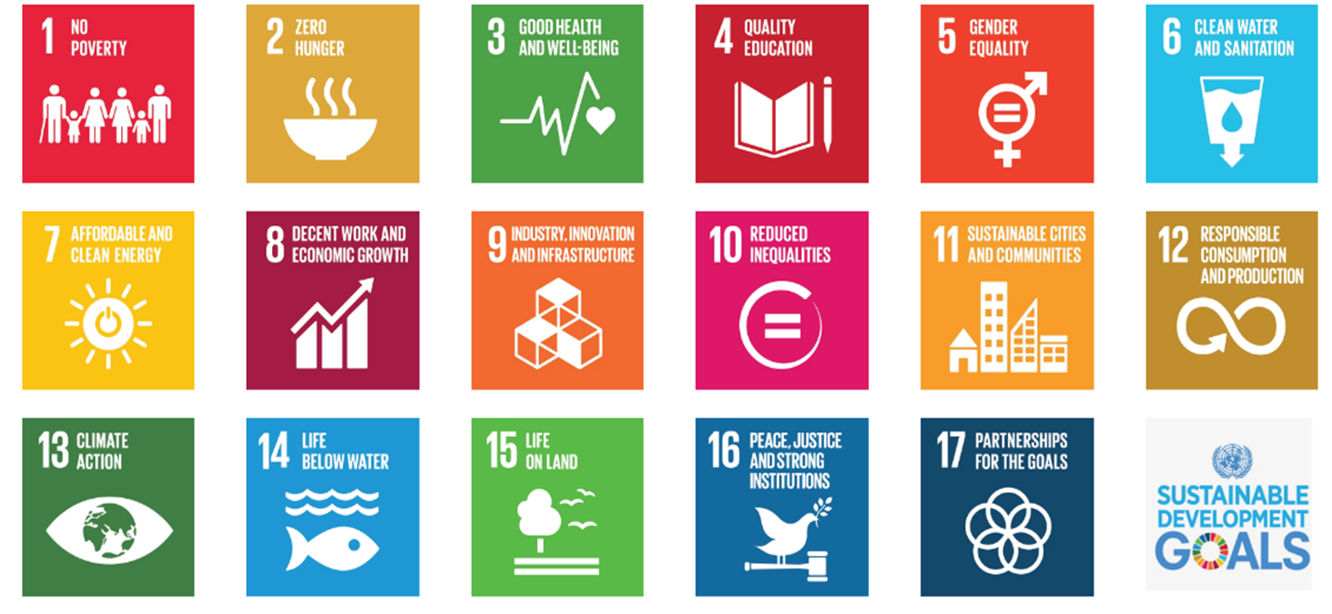
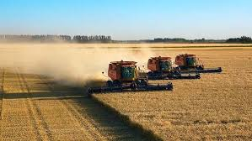
INTRODUCTION
Sustainable Development Goals (UN 2015)
Agriculture is at the heart of SDG
Economic
Social
Environmental
Agriculture and Food Production
Industrial
Extensive
Companies-Traders
Land concentration
Intensification

Slide 3
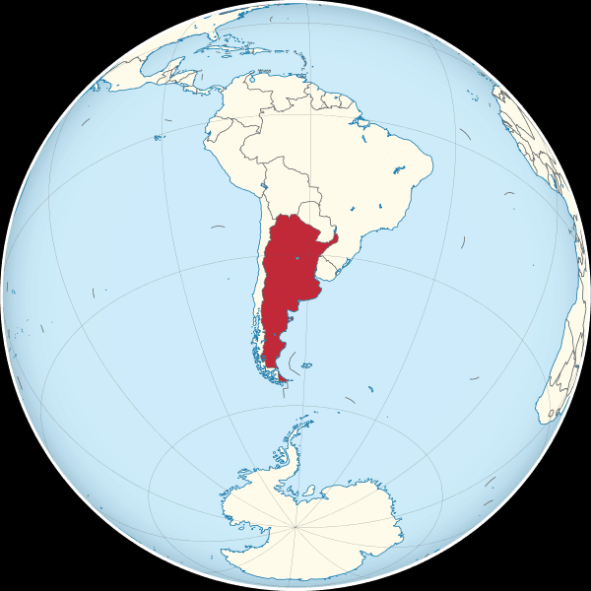
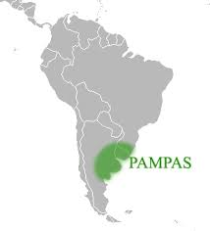
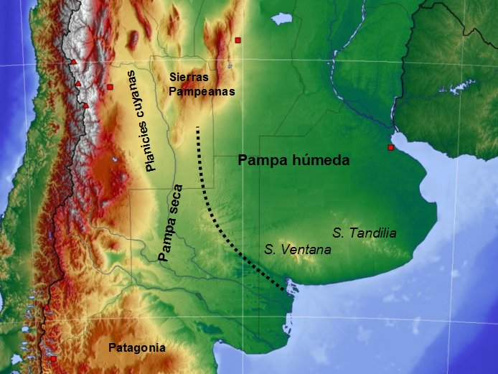
Agriculture in Argentina
“Pampas” located
Commodities (soybean, wheat, maize)
32 M ha – 150 M ton
Rented Land
Green Revolution paradigm
Notes:
In Argentina, agriculture has these main peculiarities…Located in the Pampas: vast and fertile plains spread out in the central part of Argentina…

Slide 4
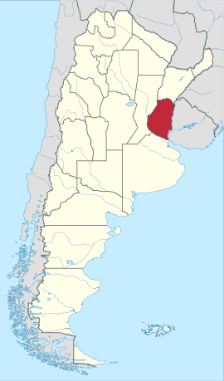
Entre Ríos Province
7.8 M ha – 10% commodities production
70% on rented land
Crops – Beef cattle-Milk cattle
1.3 M inhabitants
15% rural population in villages and small cities
European immigration (XIX and XX centuries)
Land session by the Government
Production and industrialization locally specialized
Public growing concerns on the way of agriculture production based on the techno-productive system
Increasing tensions: production/environment - rural/urban
Notes:
Our case study was on an Argentinian province, Entre Rios (among rivers) where input-based agriculture has advanced rapidly over the past three decades.
This is a province of 7 million hectares, with 2 million hectares under agriculture, accounting for 10% of national production of commodities.
70% of this agriculture is carried on rented land.
A distinctive feature of this province is that it still maintains 15% of its population in small towns and villages, and dispersed.
This is the result of at least three historical facts
This situation resulted in…

Slide 5
Prospective Studies
Recent in Argentina
Sustainable Development Goals (SGDs)
Local dimension
Subnational level
Historical dimension for understanding drivers
Sustainable scenarios
Public policies within a political project
Future vision
Ideology
Conduction
Social base
Technical background
Roadmap transition
Notes:
Prospective studies. In relation to future studies or prospective studies in Argentina, we can say that they are..
for the study, our approach was guided by…
With all of this we try to outline a roadmap…for transition

Slide 6
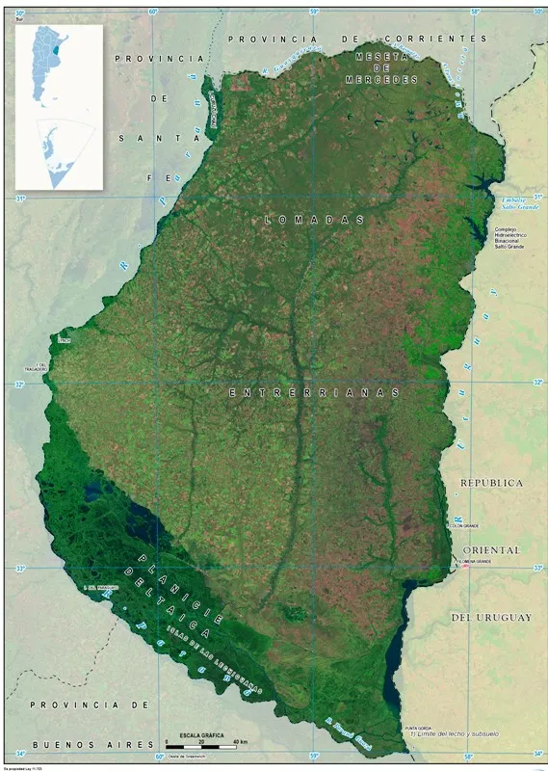
Our Work
Describes a prospective study in the Entre Ríos Province, Argentina.
The study
Focused on agriculture (broad sense)
Participatory and multidisciplinary approach
Temporal horizon 2030
Drivers
Trending scenario-business as usual (BAU2030),
Desirable scenario (SA2030)
Backcasting from 2030 vision
To create a transition pathway
To project mayor steps toward a desirable future
Notes:
Our work:
Describe a process, a study of prospective
The study had two main pillars
We focused on identifying drivers from attributes we consider essential for a desirable scenario
Once the drivers have been identified and selected, we advance in the main avenues of an action plan using backcasting elements in order to…

Slide 7
Participatory Instances – 5 Workshops (W_{n})
W1 (July 5, 2018)
Subject | Focus | Geographical limits | Temporal horizon | Attendants (*) experts on
Sustainable agriculture | Primary production | Entre Ríos Province | 2030 |  | Agronomy Biology Sociology Rural extension Education
* From National Institute of Agriculture Technology
Notes:
As I said earlier, participation was a central pillar in our study. We had 5 workshops. As in any multidisciplinary meeting, we grew in complexity and in efforts of synthesis and convergence
In W1, agronomist…..we were able to define …

Slide 8
Participatory Instances
W2 (August 15, 2018)
Identified milestones and probable drivers |  | Attendants (Professionals and experts on (*) | Stakeholders for next workshops
 | From the past Colonization and land access Settling of cities and towns driven by roads, railways and industries based on primary products. Genetic breeding and mechanization. Combination of two technological innovations (no-till based on herbicides and GMO soybean) From the Present New cycle of agriculture expansion on native forest and grassland , and loss of ecosystem services From the Future Relevant SDG (2, 6, 8, 11, 15, 17) Sustainability dimensions (productive, environmental and social) | Biology Agronomy Sociology Extension Epistemology Economy | Provincial government Agri-food organization Farmers organizations NGO Academic sector
*From INTA, FCA (UNER) and INES
Notes:
From W2 we were able to…
Identify milestones and potential drivers by looking deeper in the past, present and future and….
thinking about the stakeholders to be involved in future workshops

Slide 9
Participatory Instances
W3 (November 21, 2018)
Expertise of attendants | Attendant´s Institutions | Essential attributes for a sustainable future (*)
Agronomy Economics Biology Sociology Epistemology | National Institute of Social Studies (INES) National Institute of Agricultural Technology (INTA) National University of Entre Ríos (UNER) - School of Economic Sciences - School of Social Work and Science - School of Agricultural Sciences | Employment: full and decent Agriculture: diversified production Agroindustry: locally located and based on Bio-economy Environment: valuation and stakeholder commitment Institutions: strengthened Market: socially responsible Territories: planned and organized Rural population: linked to productive systems Food: accessible and healthy Technologies: socially evaluated Food safety Sustainable communities Active role of Government
*As an average from individual answers of attendants.
Notes:
In W3, working with experts from different institutions we were dedicated to identifyi attributes that should be part of our desirable future.
At this point, I must admit, complexity and broadness were there and a sense of frustration start to invade us. However

Slide 10
Participatory Instances
W4 (April 10, 2019)
Attendant´s institutions (*) | Sustainability dimension | Essential attributes for a desirable future
Government officials RCA Statistics Finance Department Farmer and industry organization Cereal Board of Entre Ríos Provincial Research - INES - INTA Academy (UNER) - School of Economic Sciences - School of Social Work and Science - School of Agricultural Sciences | Productive Environmental Social | Crop diversification Sustainable intensification Mixed rotations Agro-ecology Added value based on circular economy Limits to urban expansion Limits to the subdivision of economic units of land Land use and conservation plan Legislation on land use and possession Science-based legislation and regulations Restoration of lost ecosystem services Integrated management of agro-ecosystems Generation of a updated rural legislation oriented to rural well-being and deprivation Specific public policies for the sector Development local markets
* RCA: Argentina Central Region Council; INES: National Institute of Social Studies; INTA: National Institute of Agricultural Technology (INTA); UNER: National University of Entre Ríos
Notes:
However, in W4, with more stakeholders, we had the opportunity to sort and synthesize on the three dimensions of the SGDs, which was a great progress. So…we defined 15 productive, social and environmental attributes firmly associated to a desirable scenario 2030.

Slide 11
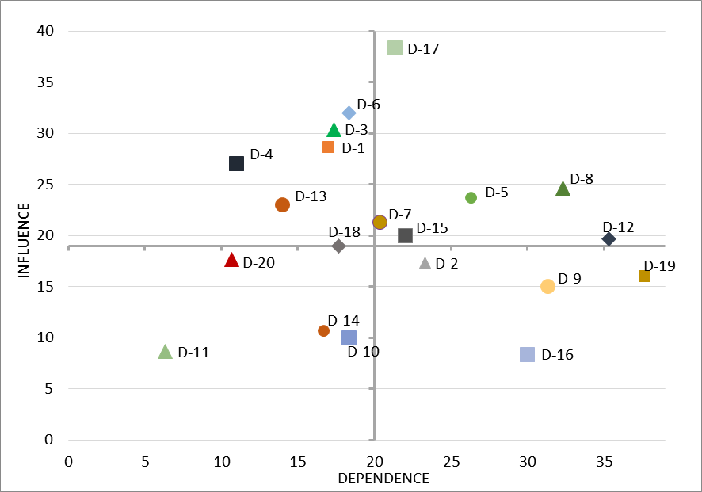
Influence vs. Dependence: “Listening to the Drivers”
BRAKES
BRAKES
DRIVING FORCES
PAST
BAU SCENARIO
Relationship between influence and dependence for drivers identified in the scenario building exercise.
Notes:
In workshop 5, we decided to listen to the drivers. To do so, we focused on the relationship between influence and driver dependence according to that indicated by Godet.
In brief, each quadrant of this figure tells us something about our drivers. Thus, the quadrant...
High High
High Low
…
…

Slide 12
Participatory Instances – 5 Workshops (Wn)
W5 (Feb 2021)
DRIVING FORCES
Relationship between influence and dependence for drivers identified in the scenario building exercise.
Notes:
That said, finally we can see the driving forces operating in our desirable scenario. We identified six DF.

Slide 13
D-1 | Technology based on high profit without evaluating social and environmental risk
D-2 | Causal chain that leads to deteriorate welfare of human being
D-3 | Lack or future studies
D-4 | Low capacity of the provincial government to regulate the accomplishment of rules
D-5 | Low economic, social and environmental resilience
D-6 | Public and private sectors bet on further strengthening industrial agriculture
D-7 | Increasing land concentration and crop production on rented land.
D-8 | Ecosystem services deteriorated in various degree
D-9 | Emerging production-environment conflicts focused on peri-urban areas
D-10 | Vicious circle between agriculture practices and effect of climate change
D-11 | Aging of farmers.
D-12 | Agriculture advance on forest, grassland and wetland.
D-13 | Weak organization and low ability to alleviate those stakeholders specifically affected by business as usual scenario.
D-14 | Limited information for key decision-makers
D-15 | Small and medium size-scale farmers with low ability for adopting based process technology.
D-16 | Productive model that hastens rural-urban migration
D-17 | Trend-driven mental model
D-18 | Role and value of the SDGs in the stakeholder's long-term agenda.
D-19 | Risks of exceeding the biological limits that support the sustainability of production systems.
D-20 | Rural advisor and public extension service focused on productive practices without a concern on environmental issues.
Notes:
Here, the red letters refer to the driving forces. D5….

Slide 14
 | Driving Force | Type | Observations
D7 | Increasing land concentration and crop production on rented land. | Structural (beyond 2030) | History Generalizations Individual and collective aspirations.
D17 | Trend-driven mental model. | Structural (beyond 2030) | Absent in both public and private agendas.
D5 | Low economic, social and environmental resilience. | Transitional | Strong red flag - warning signal
D8 | Ecosystem services deteriorated in various degree. | Transitional | Sustainable technology to recover basic environmental services (water, air, soil and biodiversity) and to slow the advance on native forests, natural grasslands and wetlands.
D12 | Agriculture advance on forest, grassland and wetland. | Transitional
D15 | Small and medium size-scale farmers with low ability for adopting based process technology. | Transitional
Notes:
However, not all these driver forces operate in the same way. Indeed, two out of six are related to structural aspects that go beyond our prospective exercise.
for example, D7 ...is the result of...
and D17 is incredibly absent from the agendas.
Other DF are more related with the transition.
Among them, D5-resilience, appears to be a strong red flag or warning and related to the others three DF, such as…
Actions to deal with this should be oriented towards supporting …

Slide 15
Driver | Brakes for transition
D1 | Technology based on high profit without evaluating social and environmental risk
D3 | Lack of ffuture studies
D4 | Low capacity of the provincial government to regulate the accomplishment of rules
D6 | Public and private sectors complacent about further strengthening industrial agriculture
D13 | Weak organization and low ability to alleviate those stakeholders specifically affected by business as usual scenario
D18 | Role and value of the SDGs in the stakeholder's long-term agenda
Notes:
Our exercise also allowed us to see the brakes to this longed-for transition. These brakes are…

Slide 16
Bau2030
-Declining welfare of the rural population in communities or dispersed
-Production-environment-social-health tensions in peri-urban areas
-Increasing urban-rural exodus
-Increasing risk of reaching biological limits
Notes:
We were also able to achieve more accuracies about the BAU scenario. Indeed, these four aspects quickly describe our BAU.

Slide 17
Actions for the desirable scenario (SA2030)

Slide 18
 | Objectives | Actions-Tools
Short-term | To shield agricultural frontier. | Legal instrument. Adherence to SGD. Strengthening of mechanisms of control. Implementation of alliances with stakeholders that facilitate effective compliance with existing regulations.
 | To reconcile profit and environmental services on both rented and owned land. | Sustainable intensification.
 | To implement awareness-raising activities on the crossing of systemic limits. | Increasing the Government's capacity for oversight, control and monitor over specific parameters, variables and indicators.
Mid-term | To address the issue of land ownership and land use concentration. | Actions to design and implement appropriate incentives and regulations that drive the management and destination of productive land and that provide greater regulatory presence of the provincial Government to influence land concentration.

Slide 19
 | Objectives | Actions-Tools
Long-term | To rise awareness and questioning the trends that consolidate the BAU2030. To propose the construction of feasible alternatives for the productive sector. | Actions to strengthen SDGs social value in the community by doing strong policy actions in terms of communication, incentives and regulations.

Slide 20
Concluding Remarks
Need to design alternative roadmaps and addressing actions backed by appropriation and implementation of SDGs.
Actions to strengthen its capacity for oversight and control through the application of legislation (current and/or future) established on participatory and scientific criteria.
Actions to aware-raise on the crossing of systemic boundaries and the impact on biodiversity, society and the productive system.
These actions will have significant incidence on variables such as mental models or the use of productive lands.
Provincial government should be an active actor in designing and addressing these actions.

Slide 21
Thanks for your attention!

